Slide 1

CALCULATING CENTER MANAGEMENT
Project JEE
01

Slide 2

INTRODUCTION
Our idea is to create a website using Java Entreprise Edition to facilitate to students calculating their pass mark.
02

Slide 3


OUR WEBSITE
03

Slide 4
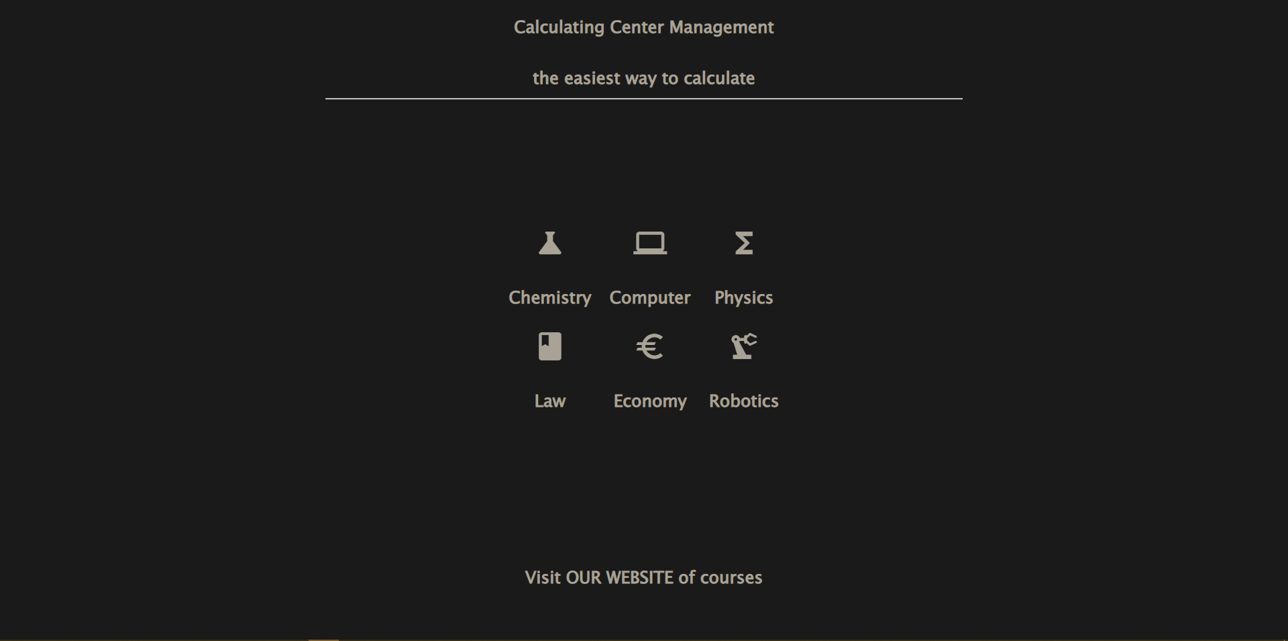
The Welcome Page
04

Slide 5
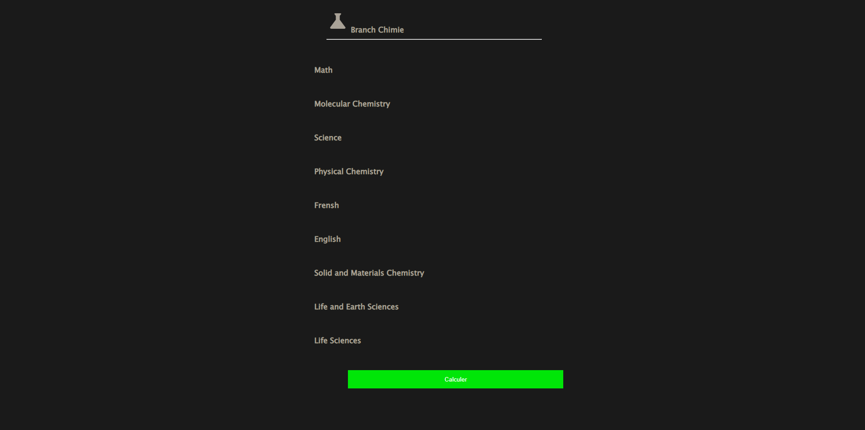
Chemistry Section
05

Slide 6
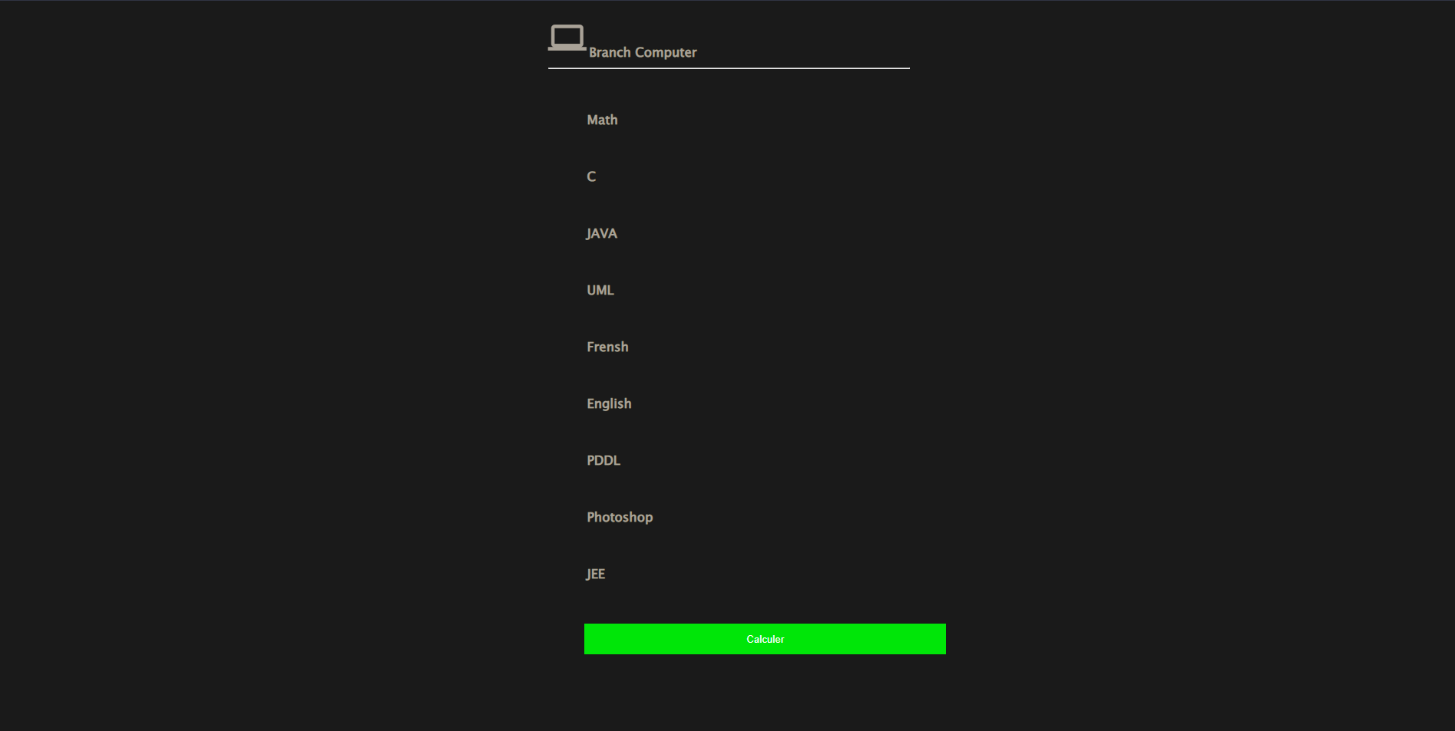
Computer Section
06

Slide 7
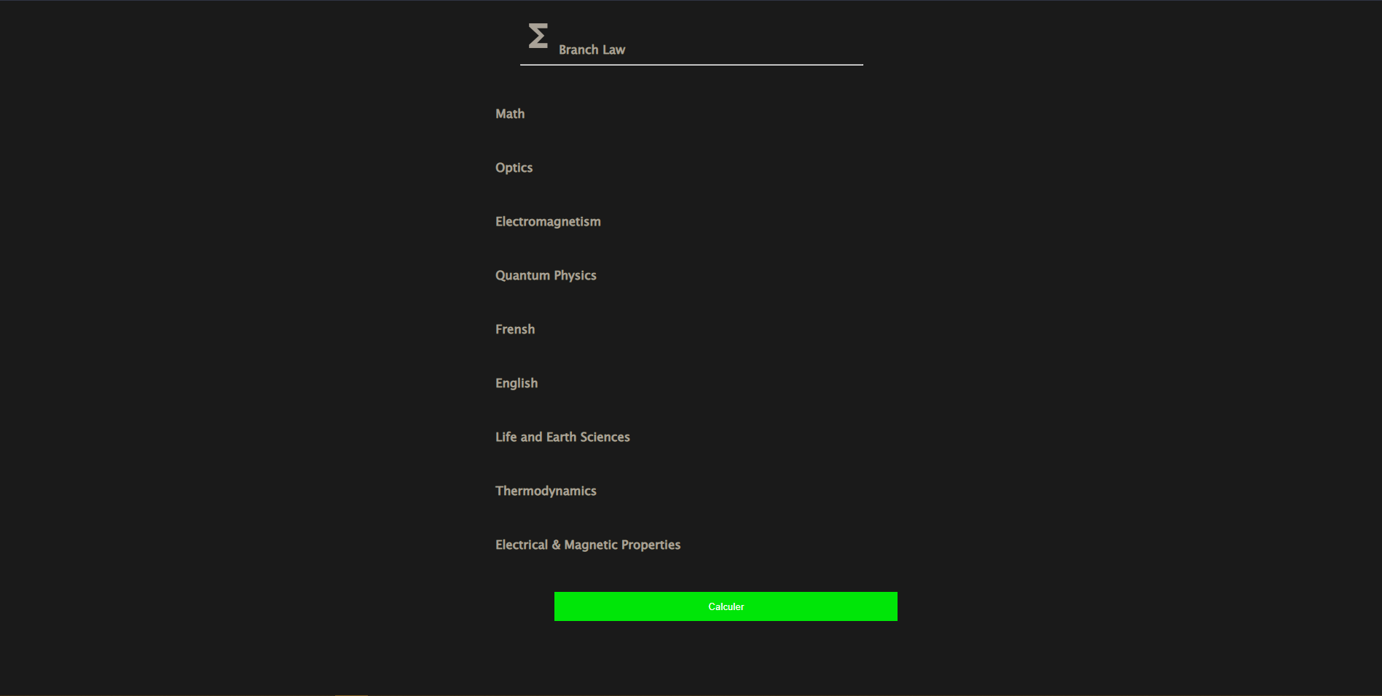
Physics Section
07

Slide 8
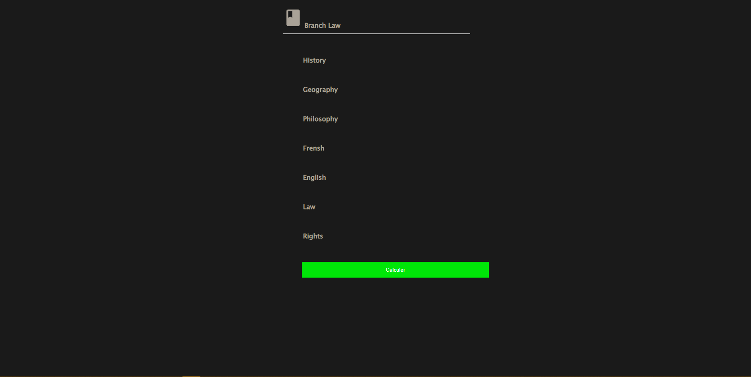
LAw Section
08

Slide 9

Economy Section
09

Slide 10
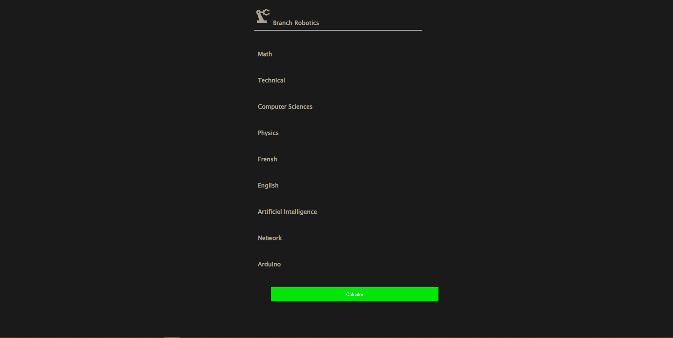
Robotics Section
10

Slide 11
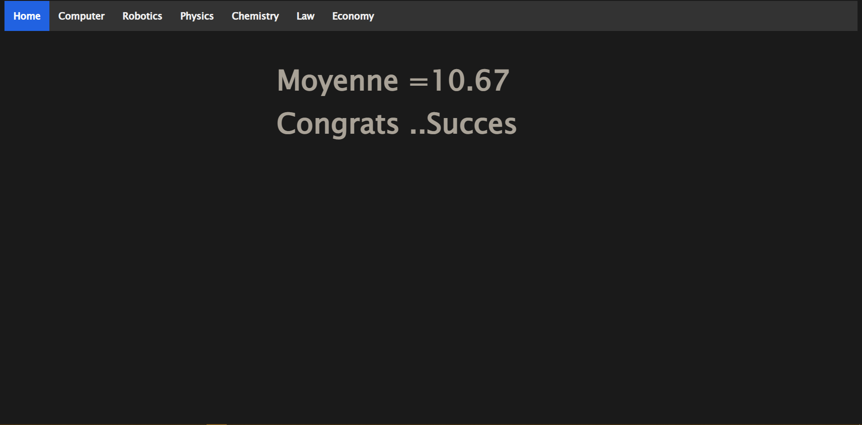
Success Section
11

Slide 12
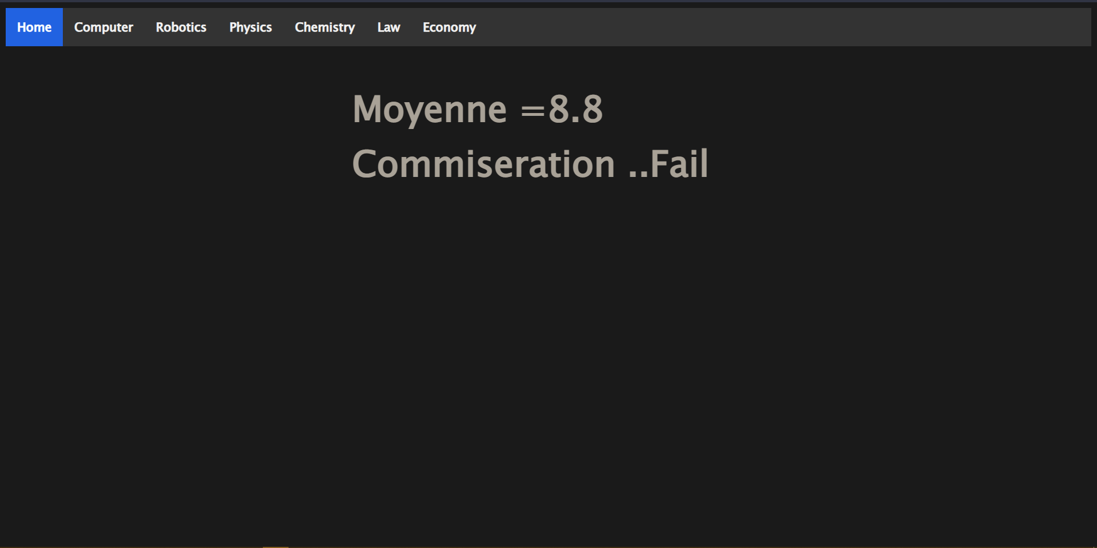
Fail Section
12

Slide 13

Button
With this label you can visit our website to reserve a course.
13

Slide 14

https://larousse2001.github.io/TrainingCenterManagement/
Training Center Management
14

Slide 15


ABOUT US
15

Slide 16




Fawz El Houda ghalba
Arous Achraf
Jmal Ahmed

